Slide 1

Welcome
Data Skills 1
Week 4: Percentages & Fractions

Slide 2
Today’s Lesson
Homework review
Week 3 recap
From decimals to percentages (and back)
The three components of a percentage problem
Fractions
Equivalent forms review
Using percentages in the retail sector

Slide 3

Homework review/week 3 recap

Slide 4
Homework review
Week 3 quiz
Kortext page 115 numbers 1-10. Answers page. 122

Slide 5
Week 3 recap
Say the following numbers.
Round to the nearest tenth:
345.67 67.81 976.89
Round to the nearest hundredth:
1056.777 2322.236 100.323

Slide 6
From decimals to percentages (and back)

Slide 7
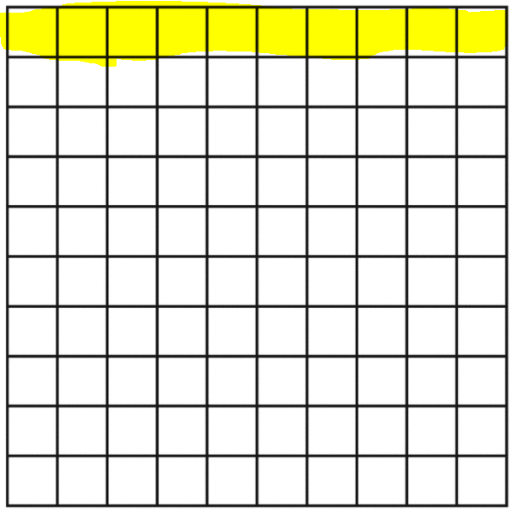
What is a percentage?
The expression “per cent” means “per hundred.”
A percentage is another way of describing part of a whole.
The box opposite contains 100 squares. The top row of ten is highlighted in yellow. Firstly, how could we read/write this as a decimal in words and as a number?
Answer: one tenth or 0.10

Slide 8
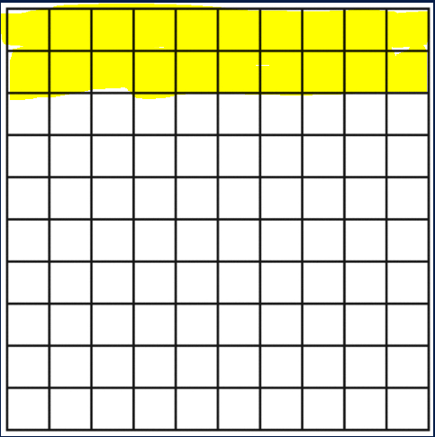
From decimals to percentages
We can also express the decimal number as a percentage. ‘One tenth’ is the same as ten out of a hundred which, as a number, is written as 10%.
This is the ‘percentage’ sign: %
Look at the box opposite. Now there are 20 boxes out of 100 highlighted in yellow. How could we express this as a percentage, a decimal number and in words?
Answer: 20% or 0.20 or two tenths
Calculation of decimal to percentage: 0.20 x 100 = 20%

Slide 9
From percentages to decimals
How do we find the decimal number if we start with a percentage?
Simply divide the percentage by 100, e.g.:
56% is 56/100
= 0.56

Slide 10
The three components of a percentage problem

Slide 11
Solving percentage problems
Percentages are a very common, if not the most common, way of presenting part of something, e.g. ‘tax bands', 'interest rates’ ‘trade markups’ and ‘discounts’ all use percentages.
We’re going to look at these examples in this module, but first, let’s look in more detail at how to work with percentages by understanding the three components of a percentage problem:
Calculating percentage ‘rate’
Calculating ‘portion’ or ‘part’
Calculating ‘base’ or ‘total’

Slide 12
Calculating the percentage ‘rate’
What is the ‘rate’, or percentage, of students with children in today’s class?
There are a total of ___ students in the class.
How many students have children? ___
The total is also known as the base.
The number of students with children is known as the portion or part.
RATE = PORTION / BASE x 100

Slide 13
Calculating ‘portion’
Sometimes, we may already have the information for the percentage rate and the base or total, but we don’t have information about the portion or part. To find this we perform the following calculation:
PORTION = BASE x RATE
Remember to change the percentage into a decimal before multiplying.

Slide 14
Calculating ‘base’
If we know the rate and the portion, but not the base or total, the calculation is:
BASE = PORTION / RATE
Remember the rate must be calculated using the decimal value
Notes:
.

Slide 15
Summary of formulas
RATE = PORTION / BASE x 100
PORTION = BASE x RATE
BASE = PORTION / RATE

Slide 16
Expressing ‘part of whole’ using fractions

Slide 17
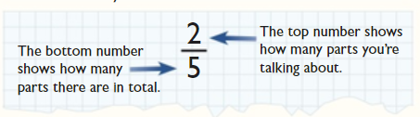
What are fractions?
So far, we’ve looked at decimals and percentages. These are both ways of describing part of a whole.
Another way of showing a part of a whole is to use fractions.
There are two parts to every fraction.
The top number is also known as the ‘numerator’ and the bottom number as the ‘denominator’.
https://library.cgpbooks.co.uk

Slide 18
Percentages to fractions
Any percentage can be written as a fraction whose denominator (the bottom number of a fraction) is 100. The fraction should be simplified if possible:
Example: Convert 59% into a fraction.
Written as a fraction.
Written as a decimal.

Slide 19




Decimals to fractions
When expressing decimals as fractions, place the non-zero digit(s) after the decimal point as the numerator (on top), and the ‘power of 10’ as the denominator (on the bottom), with the same number of zeros as there were decimal places.
Examples:
0.6 = $\frac{6}{10}$
0.08 = $\frac{8}{100}$
0.42 = $\frac{42}{100}$
0.003 = $\frac{3}{1000}$

Slide 20

Simplifying fractions
Where possible, fractions should be simplified (made smaller).
To simplify a fraction, divide both the top number (the numerator) and the bottom number (the denominator) by the same number. Keep going until it is no longer possible to divide either number without getting a decimal.
For example: $\frac{18}{100}=\frac{18}{100} ➗ 2=\frac{9}{50}$
9 can be divided by 3, but 50 cannot be divided by 3 so $\frac{9}{50}$ is the smallest fraction possible in this case.

Slide 21

Take a Break

Slide 22
Equivalent forms

Slide 23
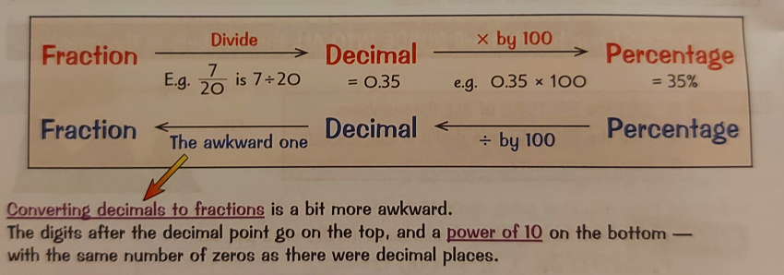
Equivalent forms
We have now looked at three different ways of representing part of a whole: decimals, percentages and fractions. The graphic below gives a summary of how to calculate from one to the others.

Slide 24
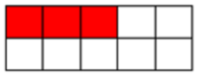
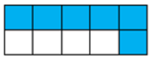
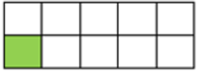
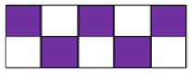
Practice
Complete the table with the correct form of the shaded squares.
Fraction | Decimal | Percentage
 | 0.3
 |  | 60%
1/10

Slide 25
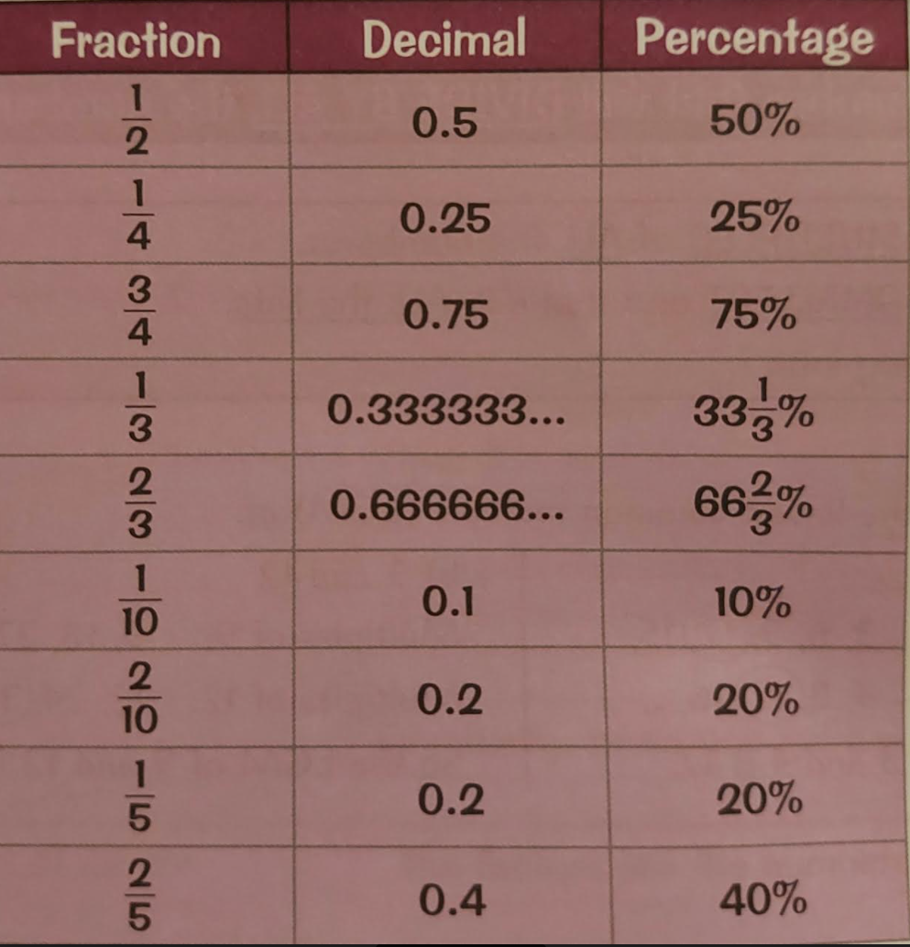
Summary of common equivalent forms

Slide 26
Using percentages in the retail sector

Slide 27
What is the retail sector?
The retail sector includes any business or individual involved with selling products directly to consumers. The retail sector includes shops, department stores, supermarkets, market stalls, door-to-door sales people and internet retailers.
https://researchbriefings.files.parliament.uk/documents/SN06186/SN06186.pdf

Slide 28
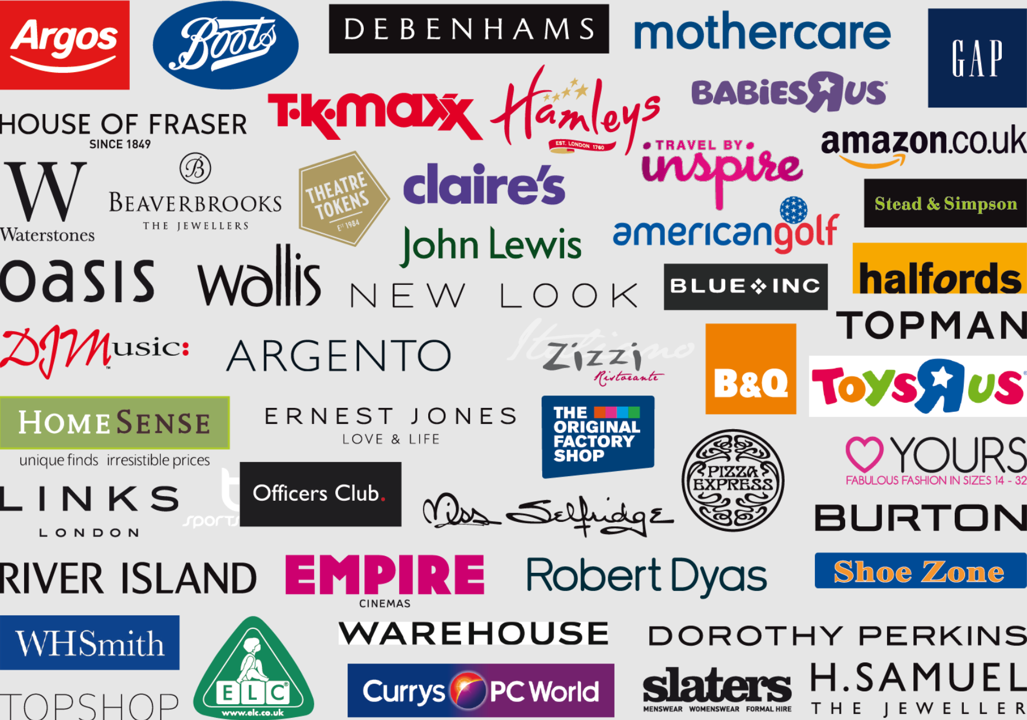
How many of these famous retailers do you know?

Slide 29
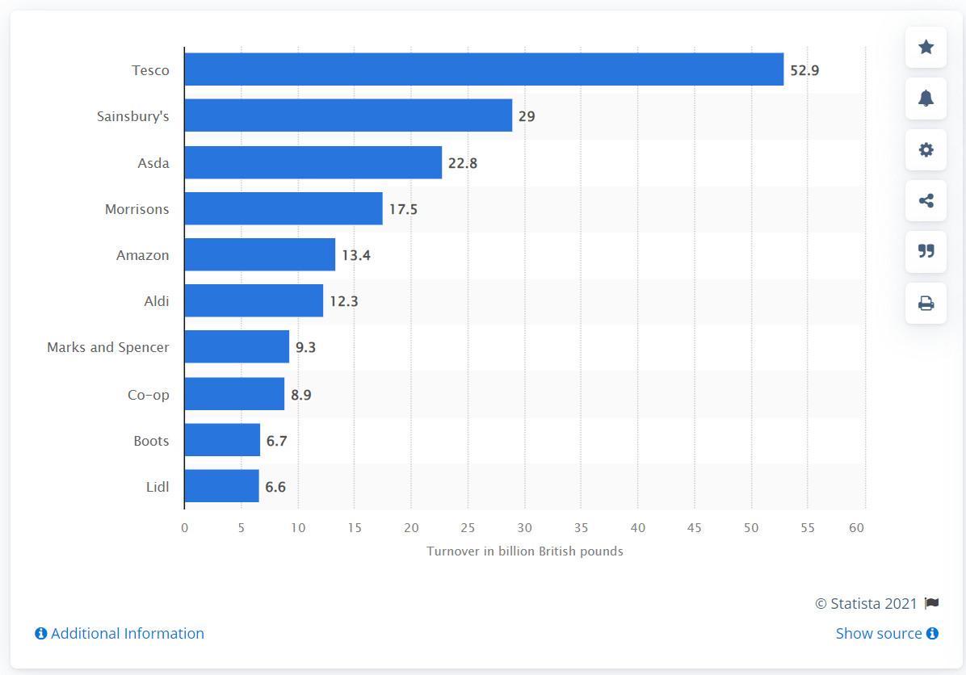
Based on ‘turnover’, can you guess which is the largest retailer in the UK?

Slide 30
Key figures
Retail sector economic output was £97.0 billion in 2020,
5.0% of the UK’s total economic output and a 2.5% fall on 2019
There were 3.0 million jobs in the retail sector in 2019
There were 310,000 retail businesses as of 1 January 2020
For every pound spent in 2020:
41 pence was spent in food shops
9 pence was spent in clothing shops
8 pence was spent on automotive fuel
8 pence was spent in household goods shops (including electronics and furniture stores)
https://researchbriefings.files.parliament.uk/documents/SN06186/SN06186.pdf

Slide 31

A common formula
What do different retailers have in common?
Whether it’s shoes, diamonds or hamburgers, retailers need to make money on the goods they sell. The price at which a retail business purchases merchandise is known as the unit cost. The retailer then sells the product at a higher price. This is known as the selling price. The difference between the selling price and the unit cost is known as the markup. In order to compare the amount of markup between products, a markup rate is used.
markup rate = $\frac{markup value}{unit cost}$ x 100

Slide 32

Example
The unit cost of a two-litre bottle of coca cola from Sainsbury’s supermarket is £0.90p. It sells the coke to the customer for £1.60. The markup value is the selling price minus the unit cost. Therefore, the markup value would be £0.70p.
Markup rate = $\frac{0.7}{0.9}$ x 100
The markup rate on a bottle of coke sold at Sainsbury’s would therefore be 77.7%

Slide 33



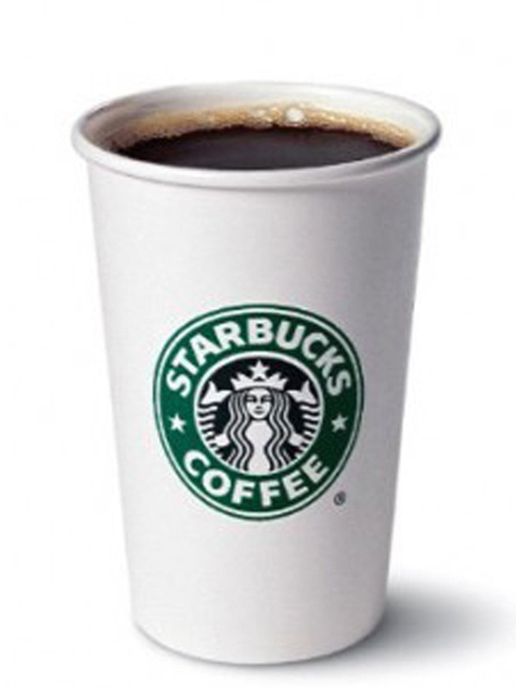
Guessing markup rate
Look at the following list of products. Put them in order of markup rate from highest to lowest
This Photo by Unknown Author is licensed under CC BY-SA

Slide 34
Why are some markup rates so high?
Consumer demand due to popular brands e.g. iPhone
Oligopoly on certain products driving up prices, e.g. diamonds
Convenience of product due to location e.g. Starbucks in a train station or popcorn in a cinema
Companies need to recoup costs of research and development e.g. iPhone
Why Companies Mark Up Their Products (Infographic) (ibrandstudio.com)

Slide 35
Homework

Slide 36
Homework
Week 4 quiz
Kortext page 390 question 1 (case study no.1)

Slide 37
End of Week 4
Any questions?

